Slide 1
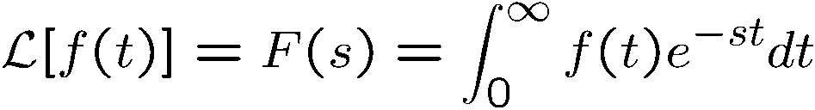


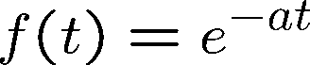
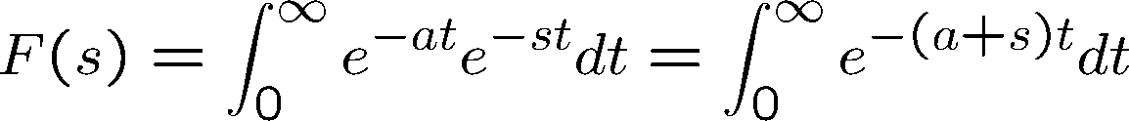
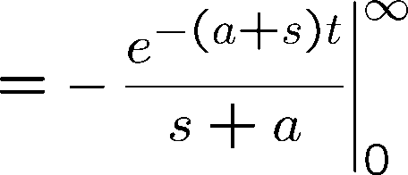
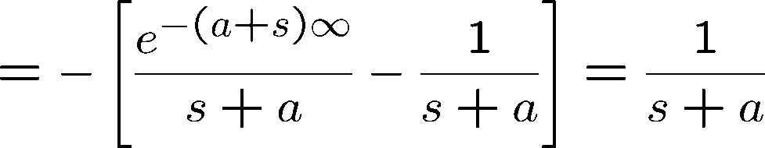
Laplace Transform
Let f(t) be a function of time t, such that f(t) = 0, for t < 0, then
is the Laplace transform of f(t). s is a complex variable
Example:

Slide 2

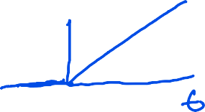

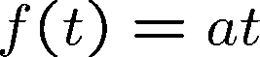
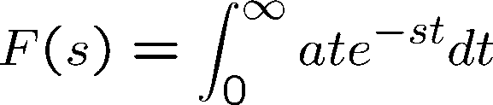
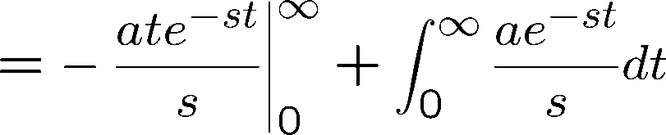
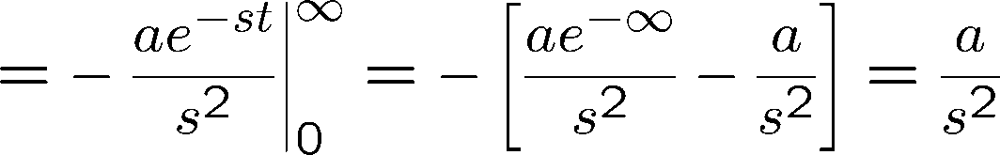




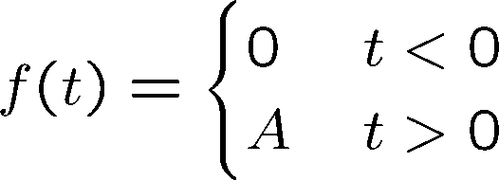



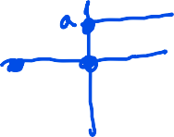


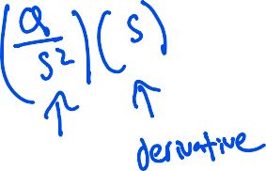

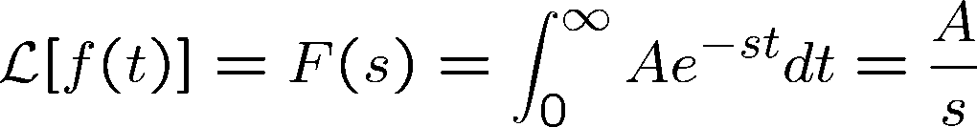
Laplace Transform
Example:
Example (Step function):

Slide 3
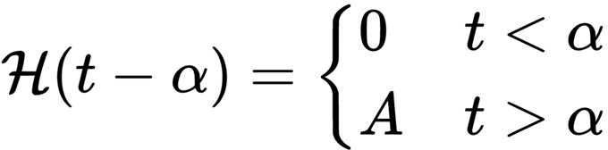
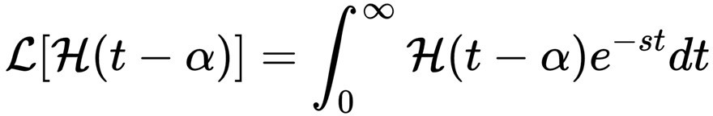

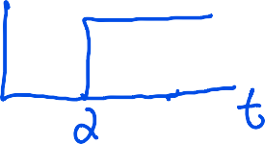
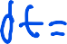

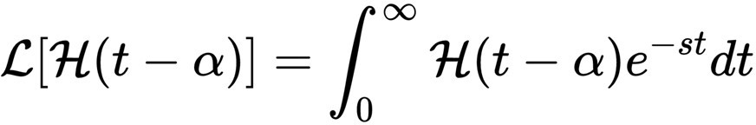
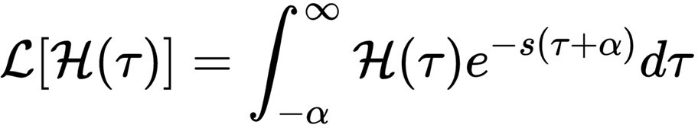
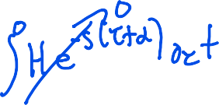

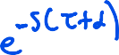

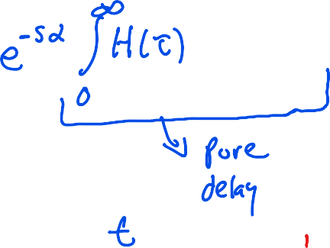


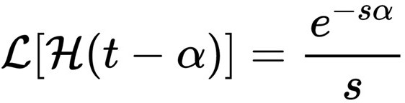

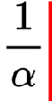




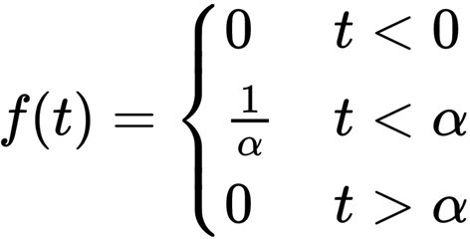

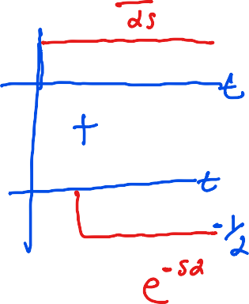
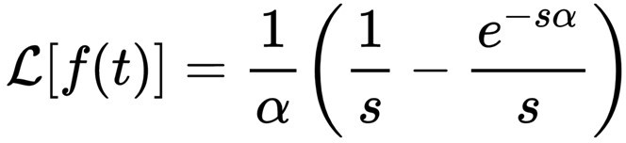










Laplace Transform (Impulse Function)
Example (Heaviside Step function):
Define
Define a pulse function as:
In the limit as
goes to zero, the Laplace transform goes to unity.

Slide 4


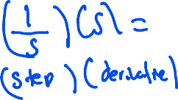


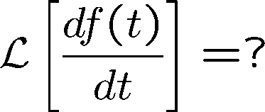
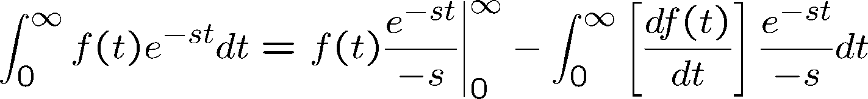
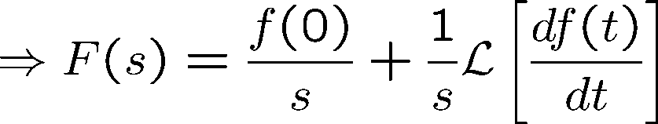
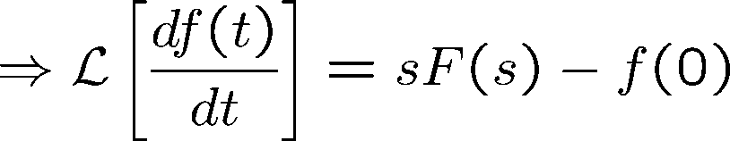
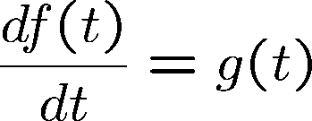
Laplace Transform of the Derivative of a Function
Consider

Slide 5

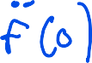

Laplace Transform of the Derivative of a Function
Similarly

Slide 6
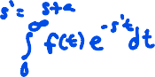
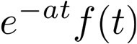



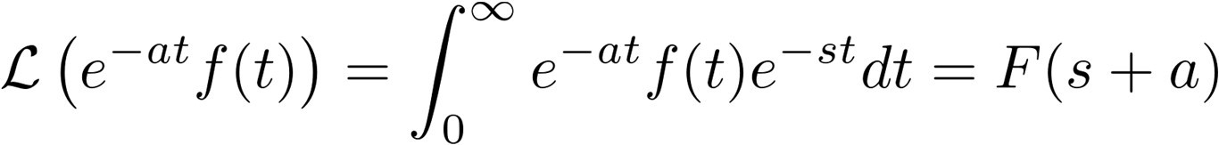
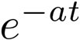
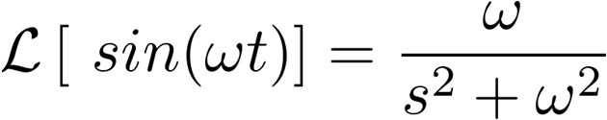
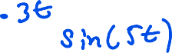



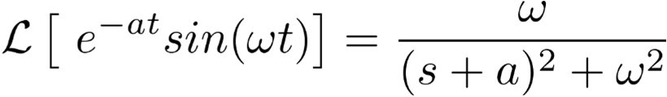

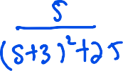


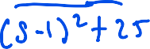
Laplace Transform of a Function multiplied by e^{-at}
Let f(t) be Laplace transformable, its Laplace transform being F(s), then the Laplace transform of
We see that multiplication of f(t) by by (s+a) in the Laplace Transform
has the effect of replacing s
Example:

Slide 7
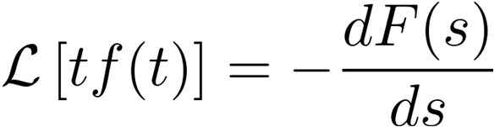
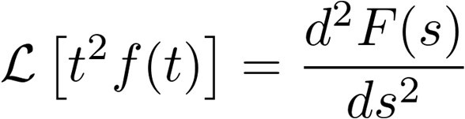
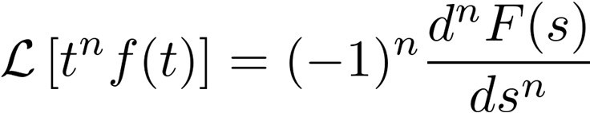

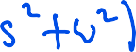




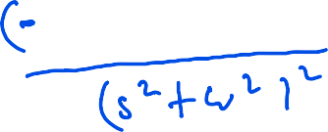
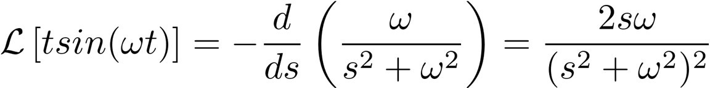


Complex-Differentiation Theorem
If f(t) is Laplace transformable, then
In general
Example:

Slide 8





Final and Initial Value Theorem
Final Value Theorem:
If f(t) and are Laplace transformable, if F(s) is the Laplace transform of
f(t), and if
exists, then
Consider
Since

Slide 9




Final and Initial Value Theorem
we have
Thus,
Final Value theorem is applicable only if
F(s) has no roots of the denominator (poles) in the complex right half plane
F(s) should have no poles on the imaginary axis, except at most one pole at s=0
Initial Value Theorem:
If f(t) and are Laplace transformable, if F(s) is the Laplace transform of
f(t), and if
exists, then

Slide 10
















Inverse Laplace Transform
Example: (Distinct Poles)
We can write
where a_{k} – residue at the pole s=p_{k.} Example:

Slide 11



Inverse Laplace Transform
therefore,
Example:
This has to be written as

Slide 12













Inverse Laplace Transform
therefore,
Example: (Multiple Poles)

Slide 13

































Inverse Laplace Transform
Consider,
Similiarly

Slide 14




Solving Differential Equations
Consider the differential equation
Define
Therefore

Slide 15























Solving Differential Equations
Consider the differential equation
Laplace transformation leads to:
Therefore

Slide 16


Transfer Function
The transfer function of a linear time-invariant system is defined to be the ratio of the Laplace transform of the output to the Laplace transform of the input under the assumption of zero initial conditions.
Consider the differential equation:
Where y is the output of the system and u is the input. The transfer function is given by taking the Laplace transform of the above equation:
The Transfer function is a property of the system itself and not a function of the input function
Transfer function of many physically different systems can be identical. eg. Spring-mass-dashpot and RLC circuit.

Slide 17







Example
For the spring-mass dashpot system
u
k
m
c
y
Force balance leads to the free body diagram
m
Assuming the initial conditions to be zero, and taking the Laplace transform of the above equation leads to:

Slide 18









Example
For the R-L-C system
L
R
Kirchoff’s law gives us
C
Assuming the initial conditions to be zero, and taking the Laplace transform of the above equation leads to:
If e_{i} and e_{o} are the inputs and outputs respectively, we have

Slide 19







Block Diagrams
A block diagram of a system is a pictorial representative of the function performance by each component and of the flow of signals. The block is a symbol for the mathematical operation on the input signal to the block.
Transfer function G(s)
Error Detector: The error detector produces a signal which is the difference between the reference input and the feedback signal of the control system.

Slide 20

Block Diagram (Closed Loop)
Summing point
Transfer function G(s)
Branch point
When the output signal is fed back to the summing point for comparison with the input, it is necessary to convert the form of the output signal to that of the input signal. This is accomplished by the feedback element whose transfer function is H(S)
Transfer function G(s)
H(s)

Slide 21




Block Diagram (Closed Loop)
The ratio of the feedback signal to the actuating error signal E(s) is called the open-loop transfer function. That is
The ratio of the output X(s) to the actuating signal E(s) is called the feedforward transfer function:
We can see from the closed loop block diagram:
Eliminating E(s) from the above equations, we have
This is called the closed loop transfer function

Slide 22








Block Diagram Reduction
D(s)
C(s)
F(s)
G(s)
Y(s)
H(s)

Slide 23



Block Diagram Reduction

Slide 24





Block Diagram Reduction (Superposition)
Assume D = 0,
C(s)
F(s)
G(s)
Y(s)
H(s)
Assume R = 0,
D(s)
G(s)
Y(s)
C(s)
-H(s)
Note: Positive Feedback)

Slide 25











First Order System
Transfer function:
Response to a unit step input is:
Partial Fraction Expansion leads to:
Inverse Laplace transform leads to:

Slide 26







First Order System
At t = T, the output is:
T represents the time required for the system response to reach 63.2% of the final value. T is referred to as the Time Constant of the system
The slope of the system response at time = 0 is:
Response of the first order system to a unit ramp is:
Tracking error as time tends to infinity is:

Slide 27



First Order System
Half-Life: Time it takes for a quantity to reduce to half its initial value. For this example, velocity to decrease to half of its initial value.
The log of the evolving output v(t) is given by the equation:
which can be rewritten as the equation:
Have life is the time required for the output to reach half its initial value, therefore:

Slide 28











Second Order System
Transfer function:
Response to a unit step input is:

Slide 29





S-plane representation
Laplace transform with zero initial conditions leads to:

Slide 30

Transient Response
In analyzing and designing control systems, we must have a basis of comparison of performance of various control systems. This basis may be set up by specifying particular test input signals and by comparing the response of various systems to these input signals. Typical test signals: Step function, ramp function, impulse function, sinusoid function.
The time response of a control system consists of two parts: the transient and the steady-state response. Transient response corresponds to the behavior of the system from the initial state to the final state. By steady state, we mean the manner in which the system output behaves as time approaches infinity.
For a step input, the transient response can be characterized by: Delay time t_{d}: time to reach half the final value for the first time.
Rise time t_{r}: time required for the response to rise from 10% to 90% for overdamped systems, and from 0% to 100% for underdamped systems
Peak time t_{p}: time required to reach the first peak of the overshoot Percent Overshoot M_{p}:
Settling time t_{s}: time required for the response curve to reach and stay within 2% or 5% of the final value. Is a function of the largest time constant of the control system.

Slide 31






Transient Response

Slide 32




Transient Response
For a step input, the transient response can be characterized by:
Rise time t_{r}: time required for the response to rise from 10% to 90% for overdamped systems, and from 0% to 100% for underdamped systems
Since
Thus, the rise time is:

Slide 33





Transient Response
For a step input, the transient response can be characterized by:
Peak time t_{p}: time required to reach the first peak of the overshoot
Thus, the peak time is:

Slide 34

Transient Response
For a step input, the transient response can be characterized by:
Percent Overshoot M_{p}:
Maximum overshoot is function of damping ratio only.

Slide 35



Transient Response
For a step input, the transient response can be characterized by:
Settling time t_{s}:
2% Settling time:
2 % Settling Time
5% Settling time:
5 % Settling Time

Slide 36

Routh Stability Criterion
Consider the closed loop transfer function of the form:
where a’s and b’s are constant and where m< n.
If any of the coefficients are zero or negative in the presence of at least one positive coefficient, there is a root or roots which are imaginary or which have positive real parts.
If all the coefficients are positive, arrange the coefficients of the polynomial in rows and columns according to the pattern:

Slide 37






Routh Stability Criterion
_{s}n | a₀ | a₂ | a₄ | a₆ | …
_{s}n-1 | a₁ | a₃ | a₅ | a₇ | …
_{s}n-2 | b₁ | b₂ | b₃ | b₄ | …
_{s}n-3 | c₁ | c₂ | c₃ | c₄ | …
_{s}n-4 | d₁ | d₂ | d₃ | d₄ | …
… | … | … | … | … | …
_{s}2 | e₁ | e₂
_{s}1 | f₁
_{s}0 | g₁
…
…

Slide 38


Routh Stability Criterion
Routh’s stability criterion states that the number of roots of the system G(s) with positive real parts is equal to the number of changes in the sign of the coefficients of the first column of the array.
The necessary and sufficient condition that all poles of G(s) lie in the left half plane is that all the coefficient of the denominator of G(s) be positive and all terms in the first column of the array have positive signs.
Special Case:
If a first-column term in any row is zero, but the remaining terms are not zero or there is no remaining term, then the zero term is replaced by a very small positive number eand the rest of the array is evaluated.
If the sign of the coefficient above the zero is the same as that below it, it indicates that there are a pair of poles on the imaginary axis.

Slide 39


Routh Stability Criterion
Special Case:
If all the coefficients in any derived row are zero, it indicates that there are roots of equal magnitude lying radially opposite in the s-plane, eg. two real roots with equal magnitudes and opposite signs and/or two conjugate imaginary roots
In such a case, the evaluation of the rest of the array can be continued by forming an auxiliary polynomial with the coefficient of the last row and the coefficients of the derivative of this polynomial in the next row

Slide 40



Routh Stability Criterion
The closed loop system can be represented as:
The Routh table for the closed loop system is:
The second and fifth row indicate that :

Slide 41


Routh Stability Criterion
The third and fourth row requires:
The requirement:
Results in a stable controller for all gains which satisfy the inequality constraints:

Slide 42
Routh Stability Criterion (Relative Stability)
Relative Stability: The Routh criteria is a tools which provides a binary answer to the question of absolute stability, i.e., whether the system is stable or not.
Relative stability permits comparing two system and gauging which system is relatively more stable. A simple characterization of relative stability is the distance of the pole with the largest real value from the imaginary axis. Closer the pole is to the imaginary axis, smaller is its relative stability. Once can use the Routh Criteria to determine the number of poles that lie to the right of a shifted imaginary axis.
Substitute s = z − σ (σ = constant) into the characteristic equation of the system and rewrite the characteristic equation in terms of z. Applying the Routh Criteria to new polynomial in z permits one to determine the number of poles to the right of the vertical line s = −σ. Thus, this test reveals the number of roots which lie to the right of the vertical line s = −σ

Slide 43

Static Error Coefficients
Consider the open loop transfer function:
which includes N poles at the origin of the s-plane.
A system is called type 0, type 1, type 2,…., if N = 0,1,2,…, respectively.
The transfer function of the closed loop system:
R(s) +
E(s)
C(s)
G(s)
-
H(s)

Slide 44


Static Error Coefficients
and the error transfer function can be calculated as:
The steady state error can be calculated as:

Slide 45


Static Position Error Coefficients K_{p}
The steady-state error of a system subject to an unit step input is:
The static position error coefficient K_{p} is defined as:
The steady state error is given by the equation:

Slide 46


Root Locus
The locus of the roots of the closed loop system as a function of a system parameter, as it is varied from 0 to infinity results in the moniker, Root-Locus.
The root-locus permits determination of the closed-loop poles given the open-loop poles and zeros of the system.
For the system:
R(s) +
E(s)
C(s)
G(s)
-
H(s)
the closed loop transfer function is:
The characteristic equation:

Slide 47


Root Locus
when solved results in the poles of the closed-loop system. The characteristic equation can be written as:
Since G(s)H(s) is a complex quantity, the equation can be rewritten as:
Angle criterion:
Magnitude criterion:
The values of s which satisfy the magnitude and angle criterion lie on the root locus.
Solving the angle criterion alone results in the root-locus. The magnitude criterion locates the closed loop poles on the locus.

Slide 48


Root Locus
Often the open-loop transfer function G(s)H(s) involved a gain parameter K, resulting in the characteristic equation:
Then the root-loci are the loci of the closed loop poles as K is varied from 0 to infinity.
To sketch the root-loci, we require the poles and zeros of the open-loop system. Now, the angle and magnitude criterion can be schematically represented as, for the system:

Slide 49



Root Locus
Im
Im
s
A₂
q₂
q₂
X
X
-p₂
-p₂ A₂
A₁
s
A₄
B₁
A₃
A₄
q
f
q
A
1
q
4
1
1
q
f
B₁
1
X
-p₄
-z
X
Re
X
-p₄
4
-z
1
X
Re
1
-p₁
1
-p₁
A₃
q₃
-p₃
q₃
X
X
-p₃

Slide 50

Root Locus (Example)
Asymptotes of the root-loci as s tends to infinity can be determined as follows: Select a test point far from the origin:
and the angle criterion is:
or, the angle of the asymptotes are:
For this example, they are 60º, -60º, -180º.
To draw the asymptotes, we must find the point where they intersect the real-axis. Since, the transfer function for a test point s far from the origin permits us to approximate the transfer function as:

Slide 51







Root Locus (Example)
The angle criterion for the approximated system is:
Substituting
, we have
Taking the tangent of both sides, we have:
which can be written as:

Slide 52



Root Locus (Example)
The three equations result is three straight lines shown below, which are the asymptotes, which meet at the point s=-1. Thus, the abscissa of the intersection of the asymptotes and the real-axis is determined by setting the denominator of the approximated transfer function to zero and solving for s.
Im
-1
Re

Slide 53


Root Locus (Example)
The root loci starting from 0 and -1, break away from the real axis as K is increased. The breakaway point corresponds to a point in the s-plane where multiple roots of the characteristic equation occur.
Representing the characteristic equation as:
We know that f(s) has multiple roots at s = s₁, if
Which when substituted into Equation 1, gives us:

Slide 54



Root Locus (Example)
Consider the equation:
which can be rewritten as:
The derivative of K with respect to s gives:
Which when set to zero gives the same constraint as before:
Therefore, the breakaway point can be determined by setting:

Slide 55




Root Locus (Example)
For the current example, we have:
The derivative of K with respect to s gives:
or
Since the breakaway point must lie between 0 and -1, s = -0.4226 corresponds to the actual breakaway point and the corresponding gain is:
The gain corresponding to the point s = -1.5774 is: Which belongs to the complementary root-locus.

Slide 56

Root Locus (Example)
Locations where the Root-loci crosses the imaginary axis can be determined by substituting s = jwin the characteristic equation as solving for K and s.
For the current example, we have
or
Equating the real and imaginary parts to zero, we have
which results in the solutions:
Thus, the root locus cross the imaginary axis at

Slide 57




Root Locus (Example)
Consider the system with an open-loop transfer function:
which has open loop poles at:
and a zero at
From the rule about existence of root-loci on the real axis, it is clear that to the left of the point s=-2, the entire real axis is part of the root-loci.
Since root-loci start at open-loop poles and end at open-loop zeros, we know that the two root-loci which start at the complex open loop poles should break in on the real axis and one of the root-loci should move towards s = -2, and the other towards
How does the root locus depart from
?

Slide 58


Root Locus (Example)
Consider a test point s in the vicinity of the complex open-loop pole p₁:
s
Im
q₁
X
-p₁
f₁
-z₁
Re
q₂
X
-p₂
The angular contribution of the pole p₂ and the zero z₁ to the test point s can be considered to be the same as the angle made by the lines connecting the pole p₂ and zero z₁ to the pole p₁ (if the test point is close to p₁).
Then, the angle of departure t1 is given by the angle criterion:

Slide 59



Root Locus (sketching rules)
Rule 3: A point on the real axis lies on a locus if number of open-loop poles plus zeros on the real axis to the right of this point are odd.
Rule 4: The (n-m) branches of the root loci which tend to infinity do so along straight line asymptotes whose angles are:
Rule 5: The asymptotes cross the real axis at a point given by:

Slide 60
Root Locus (sketching rules)
Rule 6: Break points (points at which multiple roots of the characteristic equation occur) of root locus are solutions of dk/ds = 0.
Rule 7: The angle of departure from an open-loop pole is given by:
where fis the net angle contribution at the pole of all other open-loop poles and zeros. Similarly, the angle of arrival at an open-loop zero is given by:
where fis the net angle contribution at the pole of all other open-loop poles and zeros.
Angle of departure from real open-loop pole or angle of arrival at real open-loop zero is always 0 or p.
Rule 8: The points at which branches cross the imaginary axis can be determined by letting s=jwin the characteristic equation.

Slide 61


Dominant Poles
The “slowest poles” of a system (those closest to the imaginary axis in the s-plane) give rise to the longest lasting terms in the transient response of the system.
If a pole or set of poles are very slow compared to others in the transfer function, then they generally dominate the transient response and are referred to as the “Dominant Poles”.
Example:
The step response appears like a first order system response since the pole at s=-0.6 is the dominant pole.

